Slide 1
MOTOR ASSEMBLY MONITORING THROUGH IMAGE ANALYSIS
Team Members-
1)Arpan Kumar
4th year ECE
Academy of technology
2) Ayush Kumar
4th year EEE
Academy of technology
Team Mentor- Anik Sardar
Manager :Sensor QC & Calibration
Prophecy Sensorlytics India PVT.LTD.

Slide 2
Problem Statement
The project focuses on developing an image analysis system to monitor the correct insertion of magnets into the rotor slots of a motor during assembly. Additionally, it includes a 3D surface scanning component to evaluate the surface roughness and depth variability of the motor post-assembly. The goal is to leverage advanced computer vision techniques to automate quality control processes, thereby reducing the reliance on manual inspections and enhancing overall production efficiency.

Slide 3
Work Approach
Data Collection and Preprocessing:
Gather stereo and RGB images of motor assemblies, including both properly placed and misaligned magnets.
Convert RGB images to grayscale and preprocess them for noise reduction.
Image Comparison Algorithms:
Develop algorithms using Structural Similarity Index (SSIM) to compare test images against reference images.
Implement pixel-wise difference calculations to quantify deviations.
Depth Analysis Using Stereo Images:
Generate disparity maps from stereo images to analyse depth discrepancies.
Utilize depth analysis techniques to detect improperly inserted magnets.

Slide 4
4. 3D Surface Scanning and Roughness Analysis:
Extract 3D data from stereo images to create a point cloud representation of the motor surface.
Analyse surface roughness and depth variability using statistical methods.
5. Decision-Making System Development:
Create a threshold-based system to automatically flag assembly or surface quality issues based on analysis metrics.
Analysed SSIM scores, insertion percentages, and surface roughness to make decisions on assembly quality.
6. Reporting and Visualization:
Generated reports using matplotlib with visualizations to display the results.
Created quality control reports indicating any assembly or surface issues detected.

Slide 5
Work products and deliverables
Software Programs: Python scripts implementing image analysis, feature matching, depth analysis, and 3D surface scanning.
Datasets: Collection of stereo and RGB images showing different magnet alignment conditions.
Input folder name of images-new_images
reference image name-magnet_insertion-proper.jpg
GitHub Repository: A repository containing all source code, datasets, and documentations are present in this link: https://github.com/arpankumar2520/IDEAS_TIH_Project/tree/my-new-branch

Slide 6
User Manual
Installation Requirements:
Ensure Python is installed on your system.
Install Jupyter Notebook.
Install necessary libraries using the command:
pip install opencv-python scikit-image matplotlib.
2. Running the Application:
Execution:
Run the main() function in the provided script.
Specify the path for the reference image is “magnet_insertion-proper.jpg” and the folder with “new_images” which is containing the test images.
Output:
View the results, including SSIM scores, surface roughness values, and insertion percentages.
Check the automatically generated reports indicating quality control issues.

Slide 7
Technical Manual
Datasets:
Captured Images: Stereo and RGB images of motor assemblies for analysis.
Software Libraries Used:
OpenCV: Image processing and feature matching.
scikit-image: SSIM calculation and surface roughness analysis.
Matplotlib: Visualization of SSIM score distributions and analysis results.

Slide 8
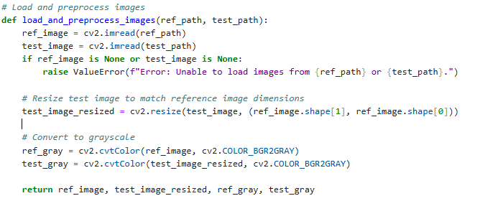
Program Documentation:
load_and_preprocess_images: Loads images, resizes the test image to the reference image’s
Here are given the reference path and input folder which present in the main function
This function loads a reference and test image, checks for successful loading, and raises an error if either image is missing. It resizes the test image to match the reference image’s dimensions, then converts both images to grayscale for further analysis. Finally, it returns the original and preprocessed images (resized and grayscale versions) for further processing.

Slide 9
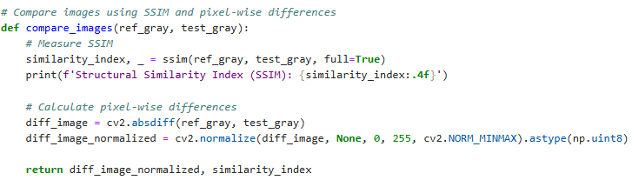
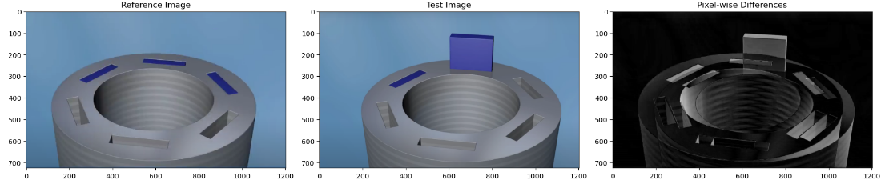
compare_images: Calculates SSIM between reference and test images.
This function compares two grayscale images by calculating the Structural Similarity Index (SSIM) to evaluate their structural similarity, printing the SSIM score. It also computes pixel-wise differences using absolute differences between the images, then normalizes the result for visualization. It returns the normalized difference image and SSIM score for analysis.

Slide 10
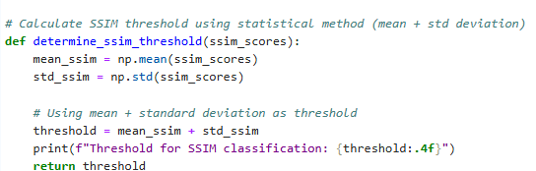
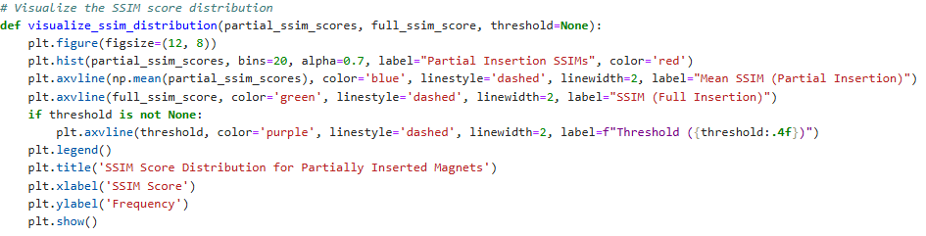
determine_ssim_threshold: Determines the SSIM threshold for classifying assembly accuracy.
The function `determine_ssim_threshold` calculates a threshold for Structural Similarity Index (SSIM) scores using a statistical approach. It computes the mean and standard deviation of the SSIM scores and sets the threshold as the sum of these two values. The function prints the calculated threshold to four decimal places before returning it.
By Using the mean plus standard deviation to determine the SSIM threshold helps identify significant differences in image quality. This statistical method provides a balance between average performance and variability within the SSIM scores, allowing for a clear cutoff point. It aids in classifying images effectively, ensuring that the assessment considers both typical performance and deviations from the norm.

Slide 11
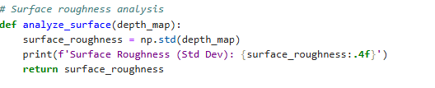
analyze_surface: Calculates surface roughness using standard deviation of the depth map.
The `analyze_surface` function evaluates surface roughness by calculating the standard deviation of a provided depth map. This measurement reflects the texture's variability, with a higher value indicating greater roughness. The function prints the surface roughness to four decimal places and returns the calculated standard deviation, serving as a quantitative assessment of the surface texture in applications like material analysis and imaging.

Slide 12
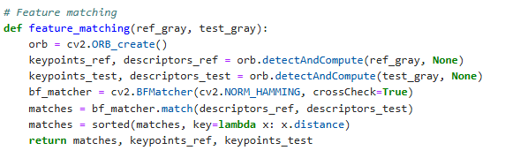
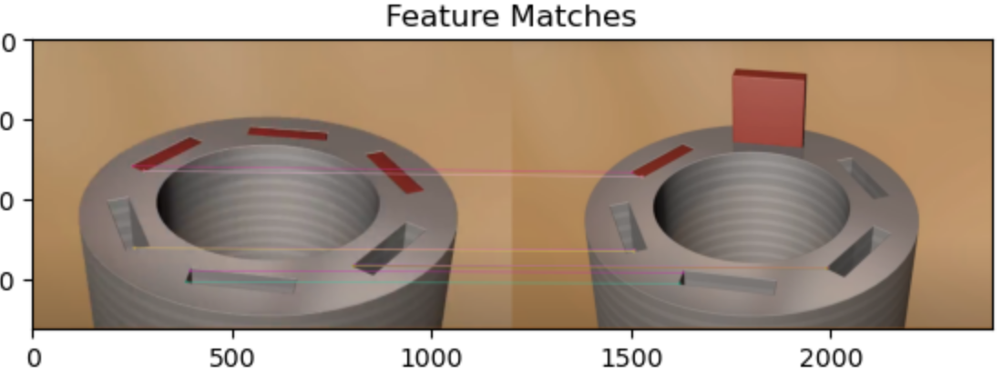
feature_matching: Matches features between the reference and test images using ORB.
The `feature_matching` function utilizes the ORB (Oriented FAST and Rotated BRIEF) algorithm to identify and match key features between two grayscale images, `ref_gray` and `test_gray`. It first creates an ORB object and detects keypoints and computes their descriptors for both images. Next, a Brute Force Matcher (BFMatcher) with Hamming distance and cross-checking is employed to find matches between the reference and test descriptors. The resulting matches are then sorted by their distance, with closer matches prioritized. The function returns the sorted matches along with the keypoints detected in both images, facilitating further analysis and comparison.

Slide 13
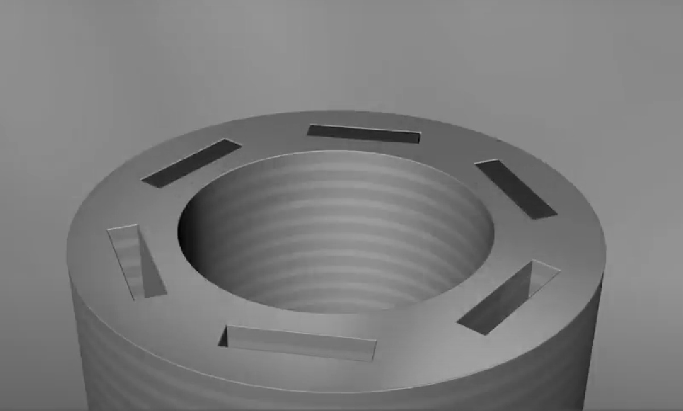
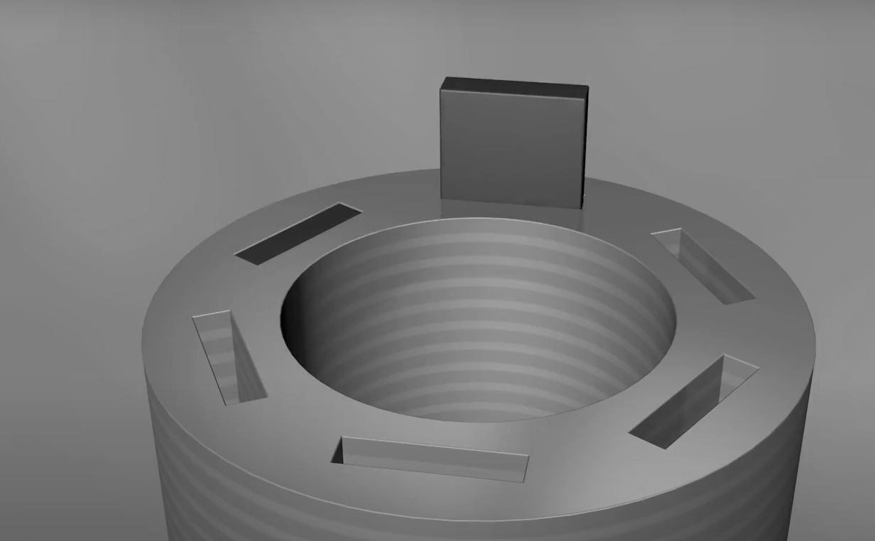

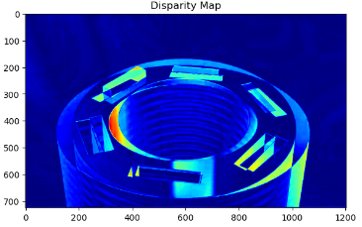
depth_analysis: Generates disparity map for depth analysis
The `depth_analysis` function computes the disparity map between two grayscale images, `ref_gray` and `test_gray`, using the OpenCV library. It employs the `cv2.absdiff` method to calculate the absolute difference between the pixel values of the two images. This disparity map highlights variations in depth, as regions with significant differences indicate greater disparities, which can be useful for assessing 3D structures or surface changes. The function returns the resulting disparity map, serving as a valuable tool for depth perception analysis in various applications, such as computer vision, robotics, and image processing..

Slide 14
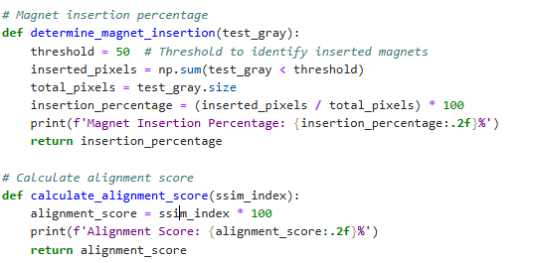
Magnet insertion percentage and alignment score
The `determine_magnet_insertion` function calculates the percentage of inserted magnets in a grayscale image, `test_gray`. It identifies inserted magnets by counting pixels below a specified threshold (50) and compares this to the total number of pixels to compute the insertion percentage. The function prints and returns this percentage. The `calculate_alignment_score` function evaluates the alignment score based on a given SSIM (Structural Similarity Index) value, multiplying it by 100 to express it as a percentage. This function also prints the alignment score, offering a quantitative measure of image alignment quality in the context of magnet insertion.

Slide 15
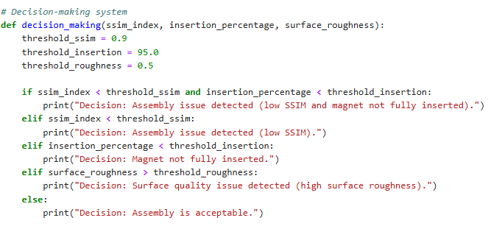
decision_making: Flags quality control issues based on thresholds for SSIM, insertion, and roughness.
The `decision_making` function assesses the quality of an assembly based on three parameters: SSIM index, magnet insertion percentage, and surface roughness. It defines thresholds for each parameter: SSIM (0.9), insertion percentage (95.0), and surface roughness (0.5). The function evaluates conditions to determine the assembly's status. If both SSIM and insertion percentage are below their thresholds, it indicates an assembly issue. If only SSIM is low, it signals an assembly problem; if insertion is low, it notes incomplete magnet insertion. A high surface roughness suggests a quality issue, while all parameters being acceptable indicates satisfactory assembly.

Slide 16
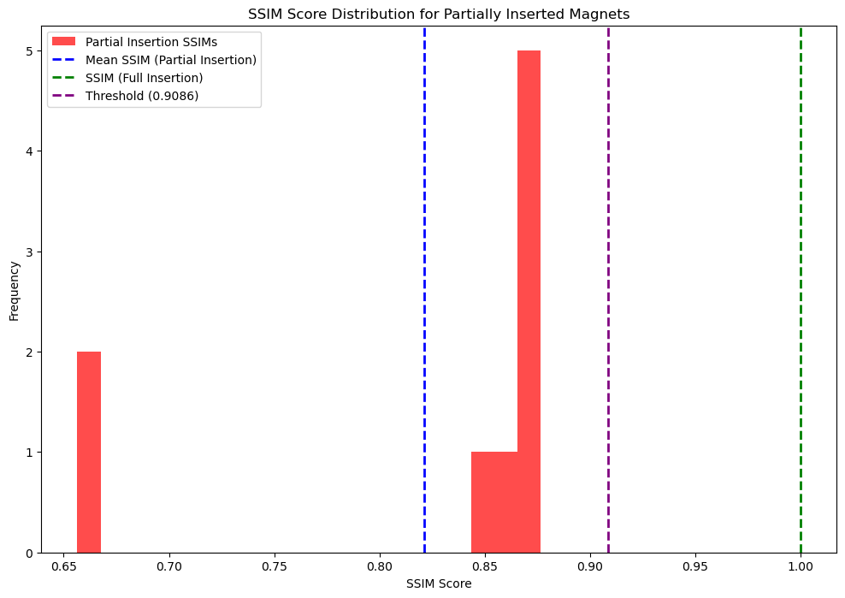
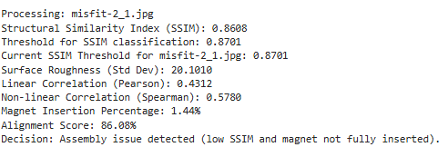
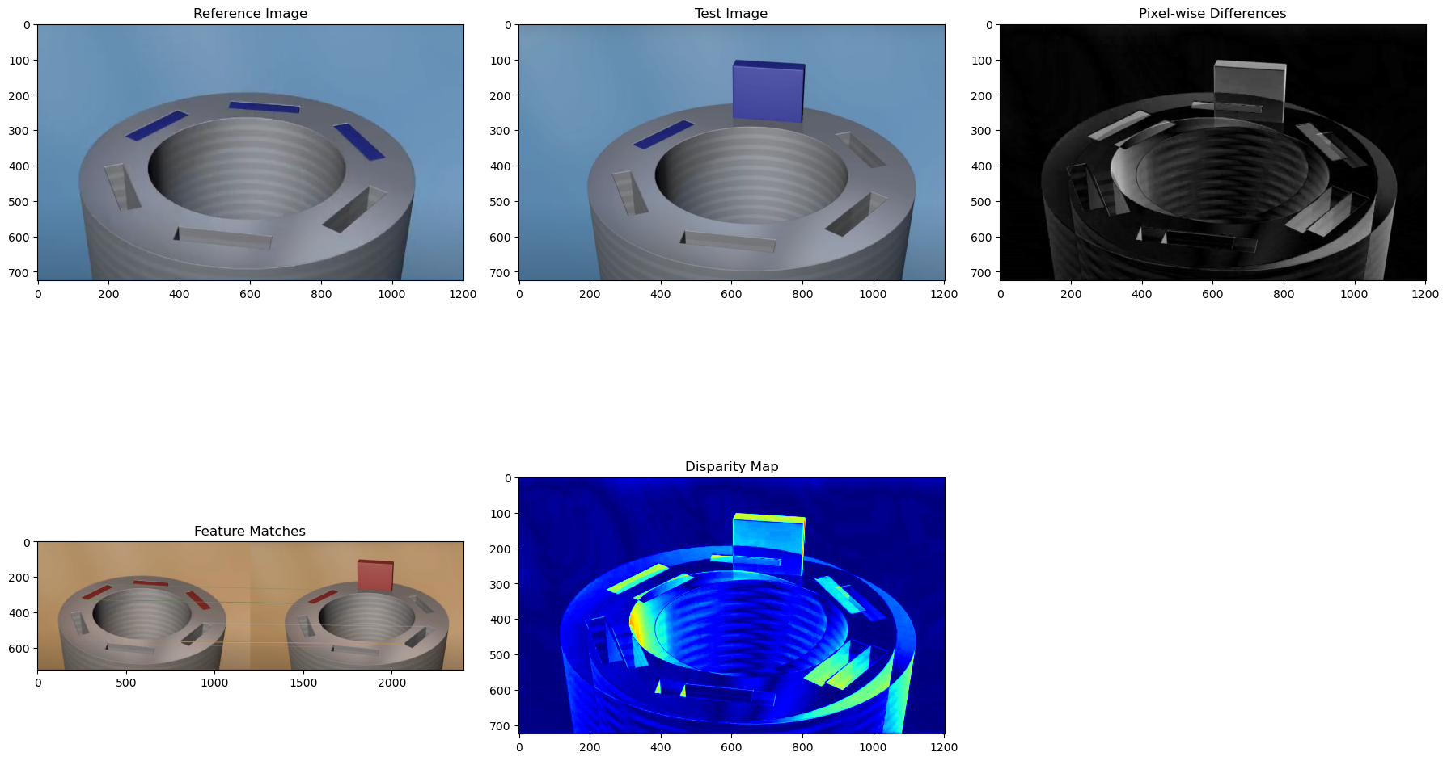

Sample output of code

Slide 17
GitHub Repository Structure
Reference image path: magnet_insertion-proper.jpg
Input folder path: new_images
Python code: Project_program.ipynb
Code pdf: Project_program.pdf
Reason for selecting or rejecting the threshold: Selecting_threshold.docx
Output image folder: output images.zip
Project report: MOTOR ASSEMBLY MONITORING THROUGH IMAGE ANALYSIS.pdf
Presentation: MOTOR ASSEMBLY MONITORING THROUGH IMAGE ANALYSIS.pptx

Slide 18
Relevance of the project to industrial applications.
The project "Motor Assembly Monitoring through Image Analysis" is highly relevant to industrial applications, particularly in the manufacturing sector. Here are some key aspects of its relevance:
Quality Assurance: By employing image analysis techniques to monitor motor assembly, manufacturers can ensure that each component is correctly positioned and fully inserted. This real-time monitoring reduces defects and improves overall product quality, essential for maintaining high standards in industrial applications.
Increased Efficiency: Automating the inspection process through image analysis significantly speeds up quality control compared to manual inspections. This efficiency allows for faster production cycles and the ability to identify and rectify issues immediately, minimizing downtime.
Cost Reduction: Detecting assembly issues early in the production process helps reduce costs associated with rework, waste, and product recalls. This project can lead to substantial savings for manufacturers by minimizing defects and improving yield rates.
Enhanced Data Analytics: The integration of image analysis with data analytics enables manufacturers to gather valuable insights regarding assembly processes. Analyzing metrics such as SSIM, insertion percentages, and surface roughness can lead to continuous improvement initiatives and better decision-making.
Flexibility in Production: The ability to adapt image analysis techniques to various types of motor assemblies makes this approach versatile. Manufacturers can implement these methods across different product lines, enhancing flexibility and responsiveness to market demands.
Compliance and Safety: In industries where safety is critical, such as automotive or aerospace, ensuring the integrity of motor assemblies is paramount. Image analysis provides an objective assessment, helping companies comply with industry regulations and safety standards.
Reduced Human Error: Automated inspection reduces reliance on human judgment, which can be prone to error, fatigue, or oversight. This leads to more consistent and reliable quality assessments.

Slide 19
Conclusion:
The program implements a comprehensive monitoring system for motor assembly through image analysis, focusing on magnet insertion quality. It begins by loading and preprocessing reference and test images, then compares them using the Structural Similarity Index (SSIM) and pixel-wise differences to evaluate assembly integrity. The system calculates various metrics, including surface roughness, magnet insertion percentage, and alignment scores, to assess the quality of assembly. Feature matching and depth analysis further enhance the understanding of discrepancies between the images. The decision-making module interprets these metrics against predefined thresholds to identify potential assembly issues, such as low SSIM values, incomplete magnet insertion, or high surface roughness. Finally, the program visualizes results and SSIM score distributions, enabling clear assessment of magnet insertion quality. This approach enhances quality control in manufacturing processes, ensuring that motor assemblies meet stringent standards for performance and reliability.
References:
Used tutorials: OpenCV,Matplotlib,scikit,python
YouTube- learned different thresholding techniques and Image Comparison Algorithms

Slide 20
THANK YOU

